Slide 1
Final Project
Jessica Liu

Slide 2
Problem Statement
What: Bacterial contamination
When: 2011-2016
Where: Grade B regulated cleanroom manufacturing environment
Extent: Organism name and counts for every lot and every sample point

Slide 3
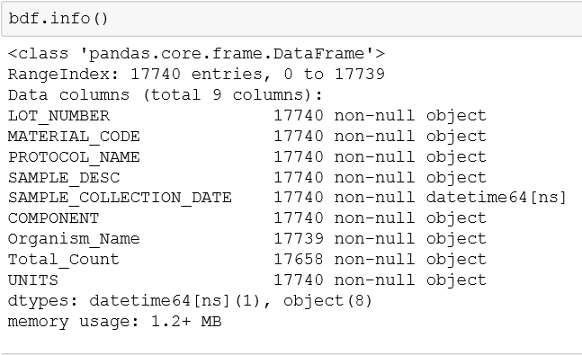
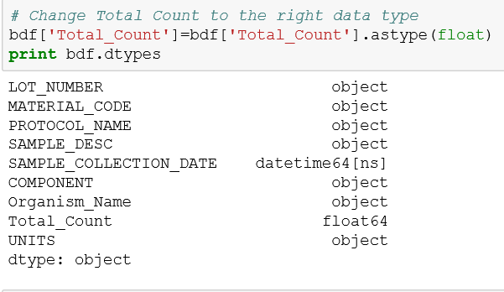
Dataset Description
Data Dictionary:
Lot_Number is a random number generator.

Slide 4
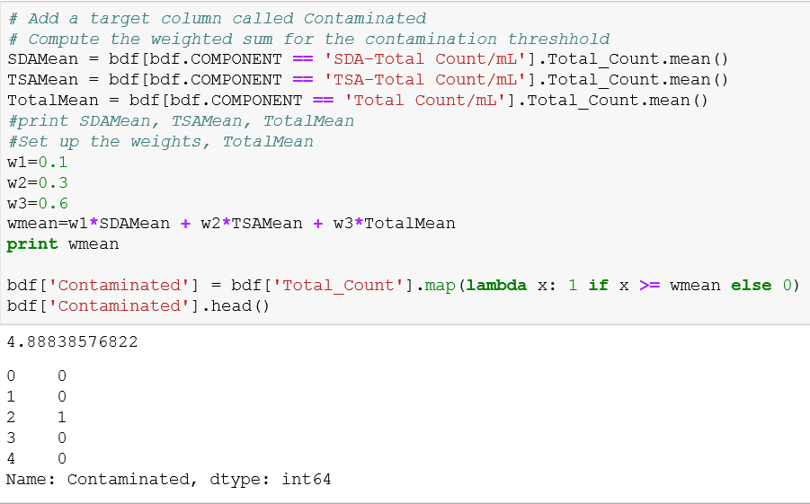
Dataset Description
Target:
The Contaminated column is the target, >4.888 CFU/mL
I didn’t have another dataset to join to this data
How it was obtained:
Source of data

Slide 5
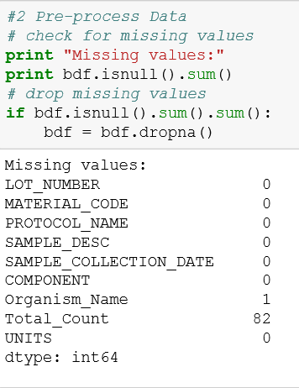
Preprocessing Steps
Data Cleaning:
As seen on the previous slide, I changed incorrect data types.
I dropped the rows that had missing data.
I did not standardize the data.
There were no non-conforming records.

Slide 6
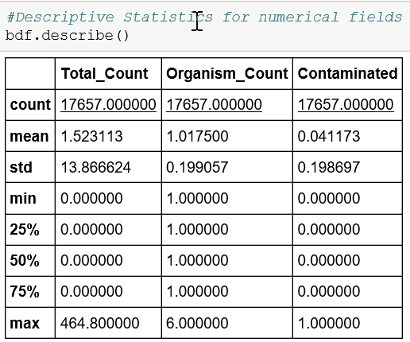
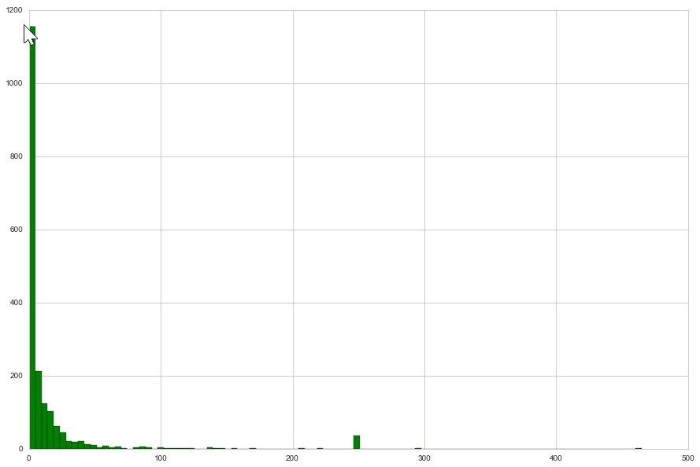
Exploratory Data Analysis Insights
The data set is imbalanced, which I already knew.
There are also several outliers with 100s of CFU/mL.

Slide 7
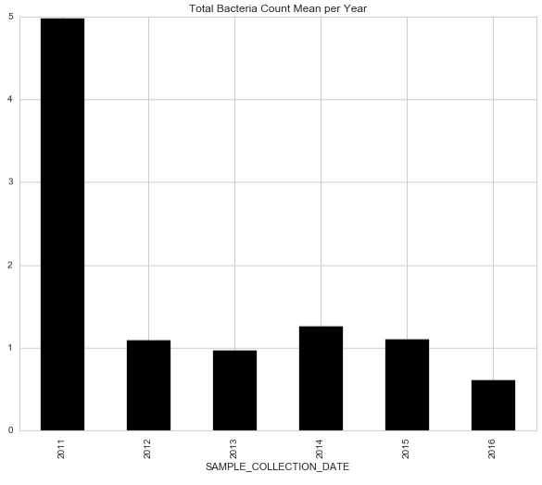
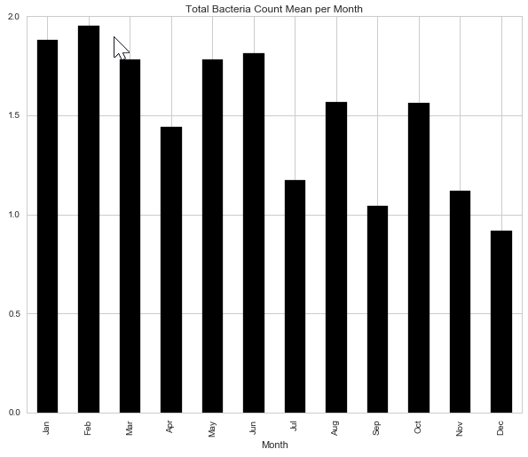
Exploratory Data Analysis Insights
Don’t know why 2011 was such a bad year. Or why Nov and Dec are such good months.

Slide 8
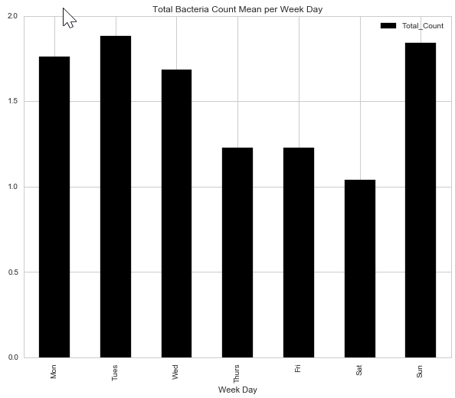
Exploratory Data Analysis Insights
Tues and Sun look like the worst days.

Slide 9
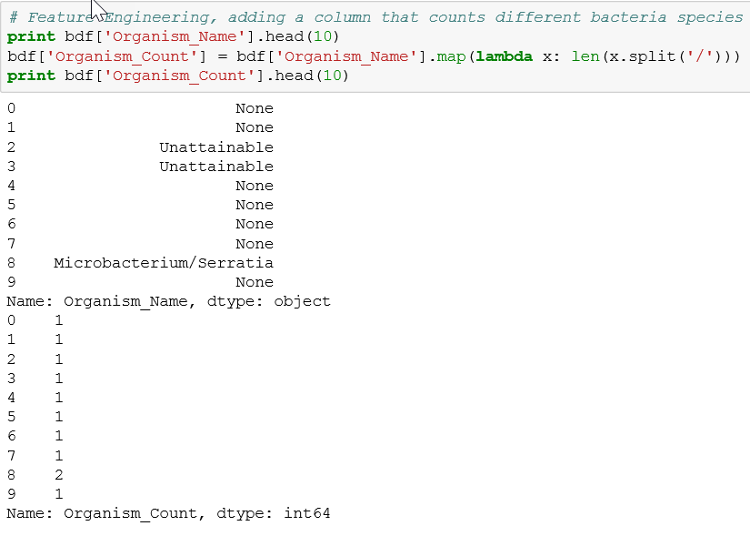
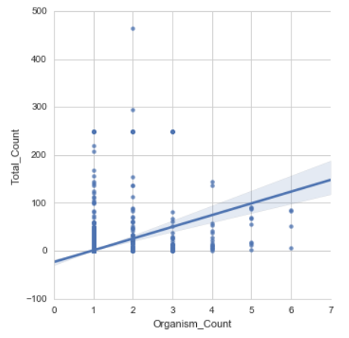
Feature Engineering
I created an Organism Count feature, which counts the number of organisms that show up in each row. I thought it would help predict Total Count, but it doesn’t. There’s no linear relationship.

Slide 10
Model Selection & Evaluation Metrics
Single Model Performance...
The different models give fairly similar AUC scores. Since the majority of my data (>80%) was uncontaminated, this might have contribted (i.e. spam and ham scenario).
Model | AUC
KNN | 0.982
Logistic Regression | 0.983
Decision Trees | 0.981
Random Forest | 0.979

Slide 11
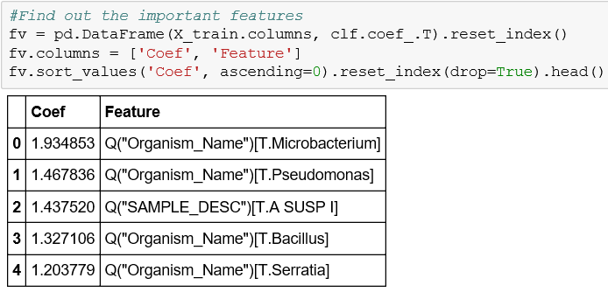
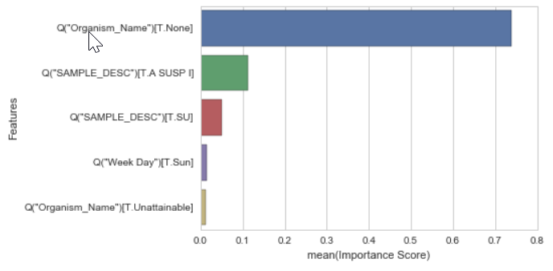
Model Selection & Evaluation Metrics
Feature Importance for Linear Regression and Decision Tree:

Slide 12
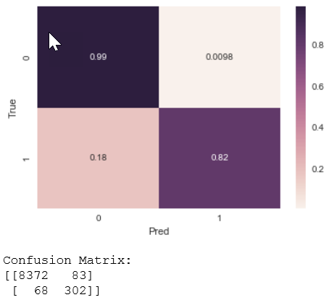
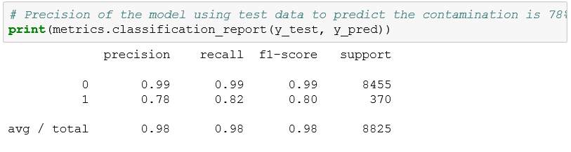
Model Selection & Evaluation Metrics
Confusion Matrix for Decision Tree:

Slide 13
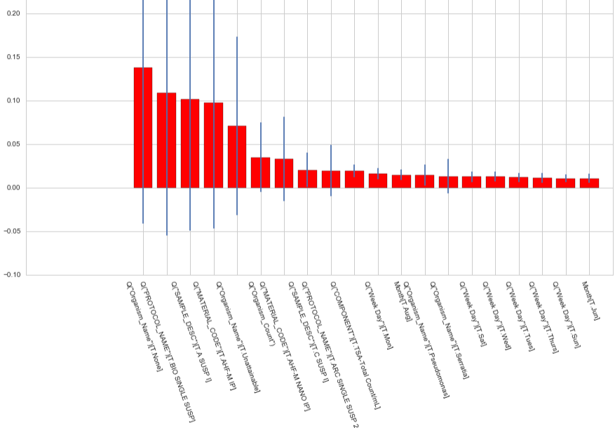
Model Selection & Evaluation Metrics
Feature Importance for Random Forest:
Giant margins of error

Slide 14
Success & Challenges
Which challenges did you find particularly difficult?
I believe the class imbalance was skewing my accuracy.
My important features didn’t make sense. And the features I thought were most important didn’t show up.

Slide 15
Next Steps
Business application of your project or possible extensions to your project
More data? No useful business applications so far.
For this project, I classified everything as contamination, but some of the organisms are actually mold and yeast. I should have Feature Engineered another column to denote that, but I ran out of time.

Slide 16
Conclusion & Key Learnings
Good exercise to run through Logistic Regression, Decision Trees, and Random Forest.
Next time will look for a dataset with more numerical columns instead of mostly objects.

